Slide 1
CRAFT MOON
BY DIVA CODES

Slide 2
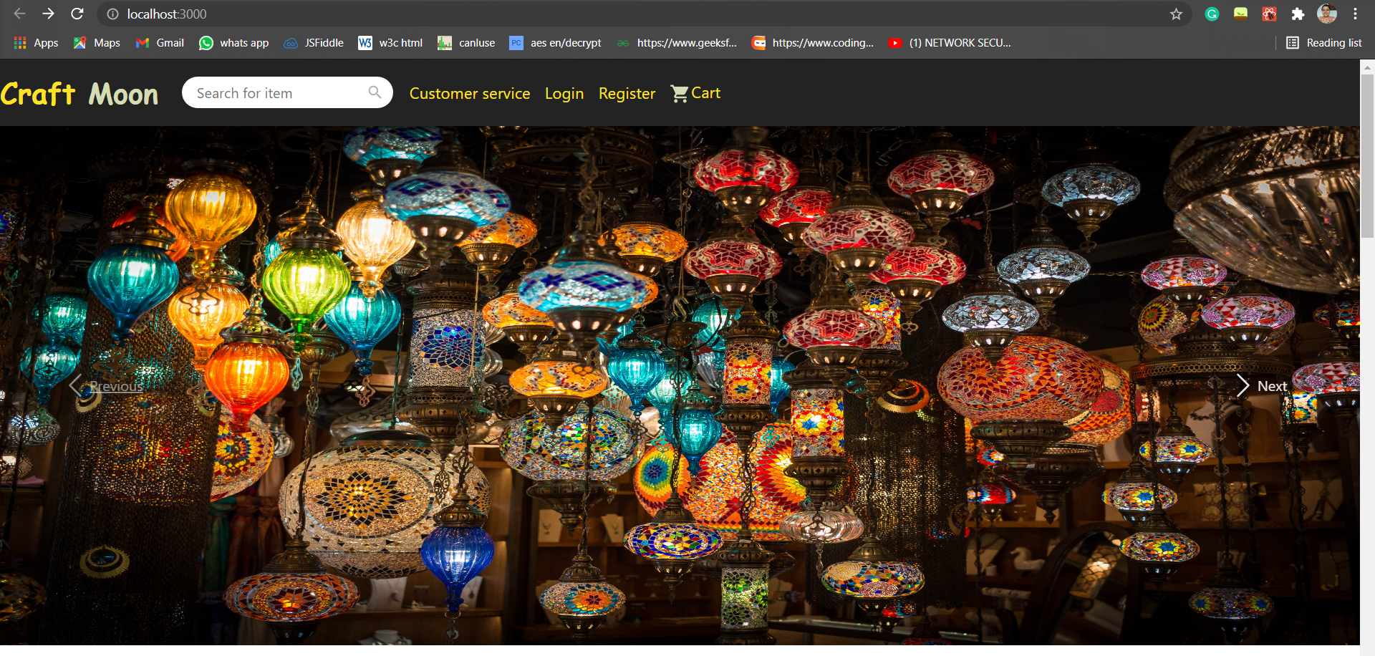
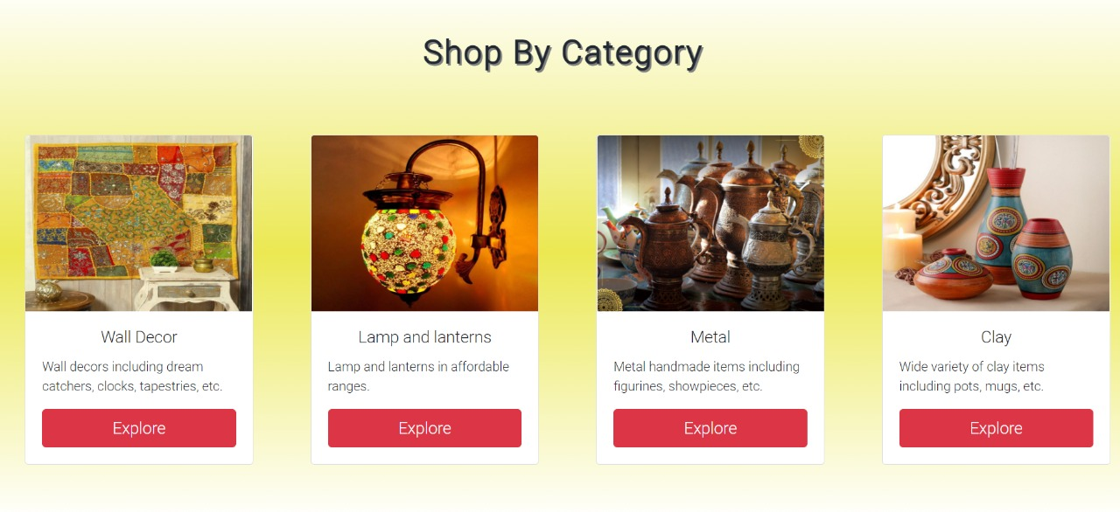
elements included:
Framework of website
Showcasing of products based on categories
Link of home page of website whose product is showcased
Link of page where the product can be bought

Slide 3
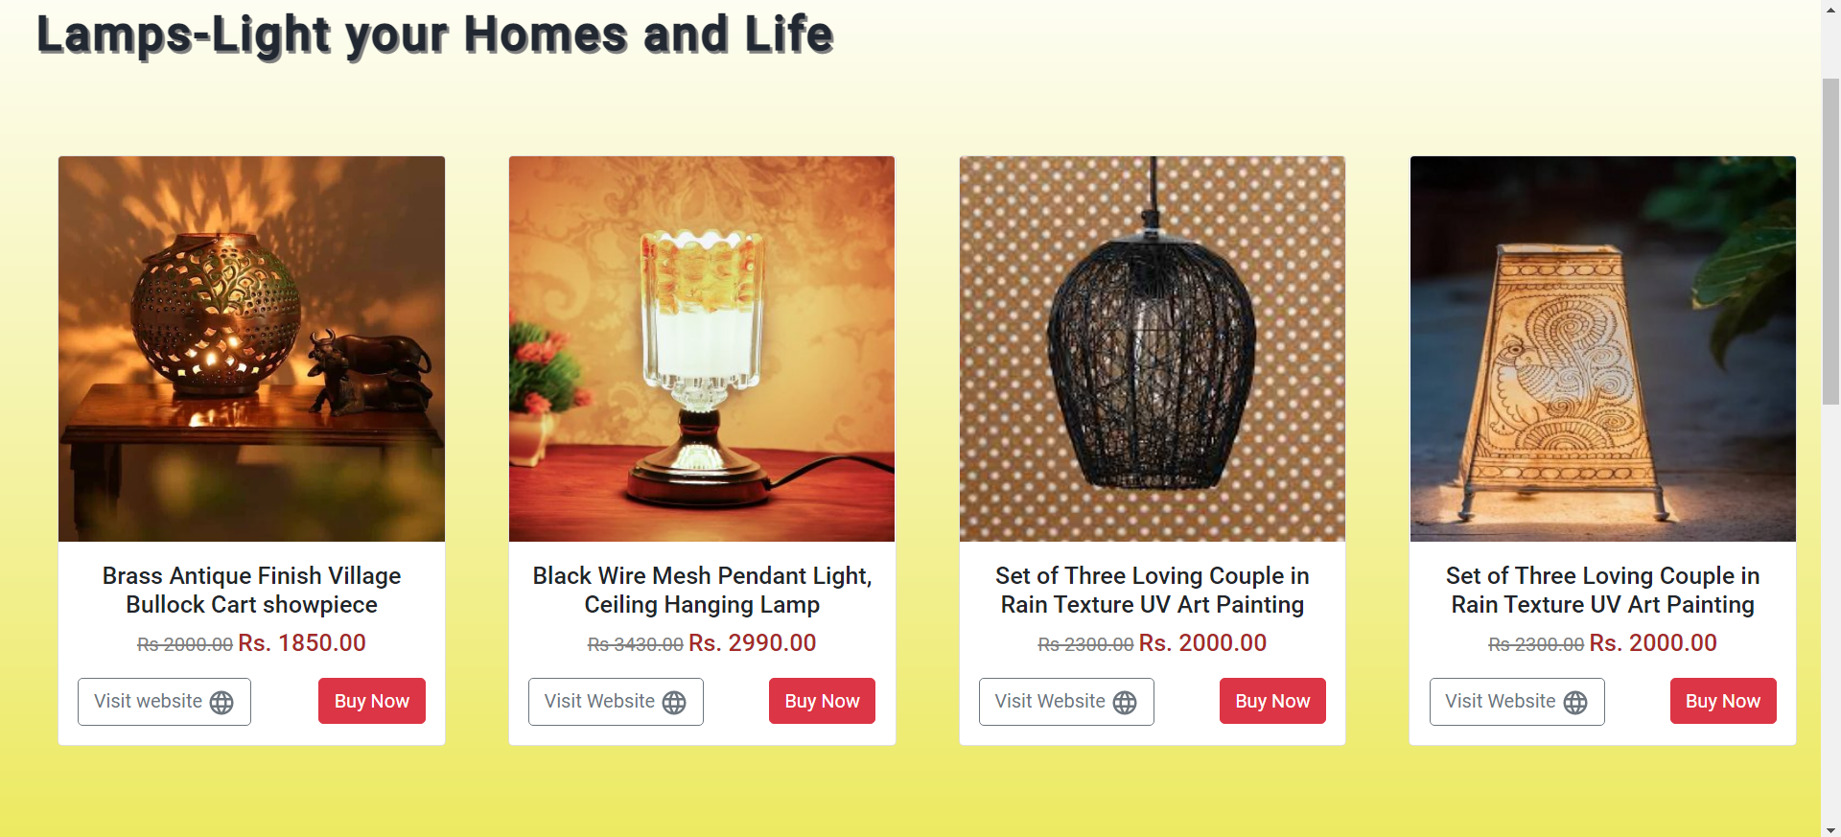
elements to be included:
Make website completely responsive
Join Us- for the artisans to connect and directly sell their goods (actual selling facility not available)
Register and Sign In pages
Animations- to make websites more lively

